Slide 1
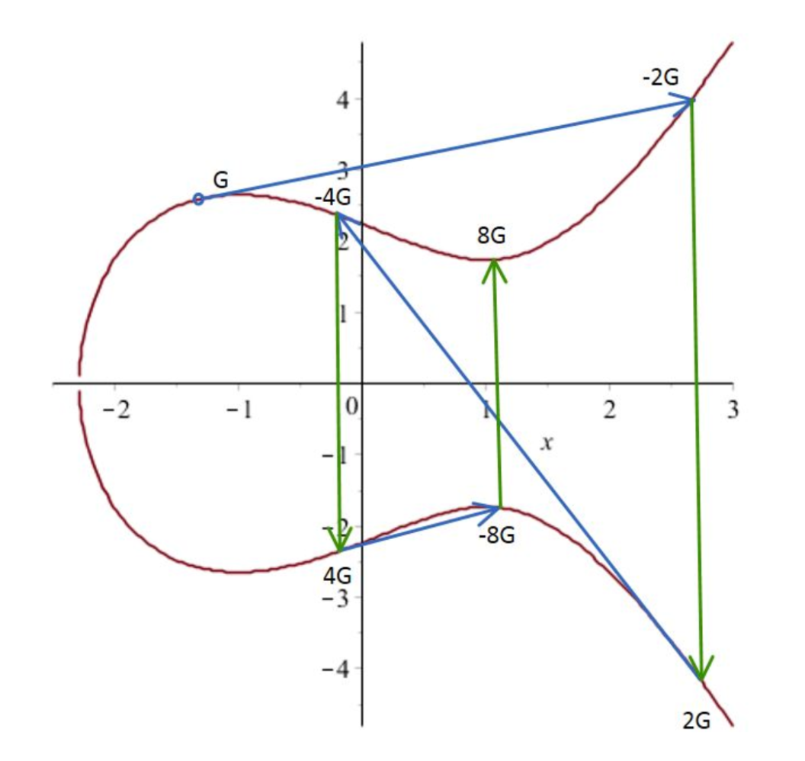
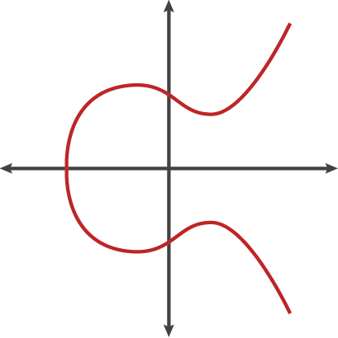
Elliptic Curve Cryptography
and Bitcoin
Alex Melville
5F11 78CD D43A 49E9 10D6 D27C 773A E36E 3704 569C

Slide 2
Update:
Video Presentation at https://www.youtube.com/watch?v=1oB-uI1C09A&feature=youtu.be&a=

Slide 3


Alex Melville
Software Engineer @BitGo
World Traveler
github.com/Melvillian

Slide 4
Why I’m talking about ECC
First attempt at explaining it failed
Bitcoin applications
Pictures!
Crypto is amazingly powerful*
* … when implemented and used correctly!

Slide 5
The Plan
Crypto Basics
Public/Private Key Digital Signatures
“Hard” problems and “Easy” problems
Discrete Logarithm Problem

Slide 6
The Plan
Crypto Basics
Public/Private Key Digital Signatures
“Hard” problems and “Easy” problems
Discrete Logarithm Problem
Elliptic Curves
EC Points
Point Addition
Finite Fields

Slide 7
The Plan
Crypto Basics
Public/Private Key Digital Signatures
“Hard” problems and “Easy” problems
Discrete Logarithm Problem
Elliptic Curves
EC Points
Point Addition
Finite Fields
ECDSA in Bitcoin
ECDSA signature
2013 Android Bitcoin Wallet screwup
Segwit (Fixing Transaction Malleability)

Slide 8
See references at the end for more!

Slide 9
Alice & Bob
Alice
Bob

Slide 10
Alice wants to send an invoice to Bob
Pay rent to account
#79BE667E

Slide 11
OK!

Slide 12
Malicious Mallory
Mallory

Slide 14
Mallory replace Alice’s message with her own

Slide 15
Mallory replace Alice’s message with her own
Pay rent to account
#CE870B07

Slide 16
Sure thing Alice!
hehe

Slide 17
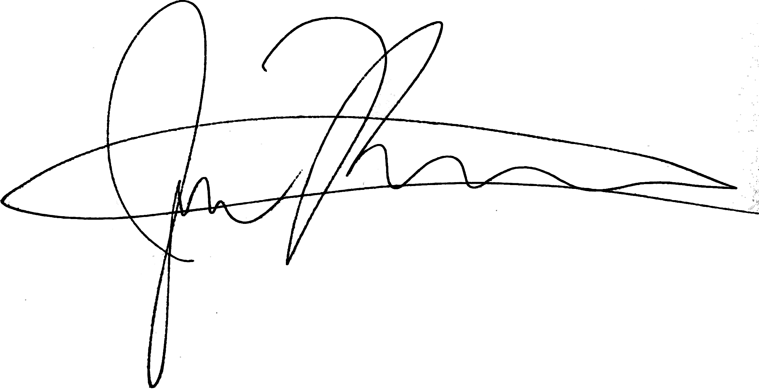
Analog Signatures

Slide 18
Digital Signatures
-----BEGIN PGP SIGNATURE-----
Version: GnuPG v1
iJwEAQEKAAYFAlRGkIcACgkQU805K63BbbvgkQP/cJktaCbNQtxCfV/ZXIiwn6Mv
tVELtCdcF/JWKD/1BPGaKXT6BiVa6vrB6dOwRWqUGiZbV1VWkj/LglaMqPa1ZEnZ
Bwpux8hyUYRNbjnyVSDYCyyBH/qvhE/9wGgeLRJ5eK/Na6QoKw4XDAo2RHoiBF3o
wwm6vk4PZF8DacCv64o=
=SadA
-----END PGP SIGNATURE-----

Slide 19
Public Private Key Cryptography
Alice
Bob
Public Key
Private Key

Slide 20
Public Private Key Cryptography
Alice
Bob

Slide 21
Public Private Key Cryptography
Alice
-----BEGIN PGP SIGNATURE-----
Version: GnuPG v1
iJwEAQEKAAYFAlRGkH…..gHFLn+Lw1x6LUroOjkl2zjpoCB
6pmQPd09MglBXJfnrBI=
=ET9V
-----END PGP SIGNATURE-----
+
=

Slide 22
Use the public key to verify the message
Bob
-----BEGIN PGP SIGNATURE-----
Version: GnuPG v1
iJwEAQEKAAYFAlRGkH…..gHFLn+Lw1x6LUroOjkl2zjpoCB
6pmQPd09MglBXJfnrBI=
=ET9V
-----END PGP SIGNATURE-----
+
=

Slide 23
Different public key *will not* verify the message
Bob
-----BEGIN PGP PUBLIC KEY BLOCK----- Version: 2.6.i mQCNAi+UeBsAAAEEAMP0kXU75GQdzwwlMiw….kYboAFx xHg43Cnj60OeZG2PKp/kU91ipOJP1cs8/xYOGkeoAMqDfwPeFlkBiA== =ddBN -----END PGP PUBLIC KEY BLOCK-----
+
=

Slide 24
Different public key *will not* verify the message
Bob
-----BEGIN PGP SIGNATURE-----
Version: GnuPG v1
iJwEAQEKAAYFAlRGkH…..gHFLn+Lw1x6LUroOjkl2zjpoCB
6pmQPd09MglBXJfnrBI=
=ET9V
-----END PGP SIGNATURE-----
+
=

Slide 25
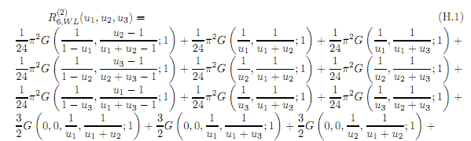
How to build a Digital Signature Algorithm?
“Easy” Problems
y = x + 2

Slide 26
Discrete Logarithm Problem
“Hard” Problems
h = G^x (mod n)
what is x?

Slide 27
These numbers are huuuuuge
2^256, 256 bits (1 followed by 77 0’s)
100000000000000000000000000000000000000000000000000000000000000000000000000000
We cannot imagine the size of this number
Age of Universe (10^10 years)
Number of atoms in galaxy (10^67)
Trillion computers doing a trillion computation every trillionth of a second (< 10^56)

Slide 28
Discrete Logarithm Problem Difficulty
Unproven!

Slide 29
Break...
Crypto Basics
Public/Private Key Digital Signatures
“Hard” problems and “Easy” problems
Discrete Logarithm Problem

Slide 30
Elliptic Curves + DLP = Digital Signatures

Slide 31

What is an Elliptic Curve?
Diophantine Equations
Addition (P + Q)
Multiplication (k * Q)

Slide 32
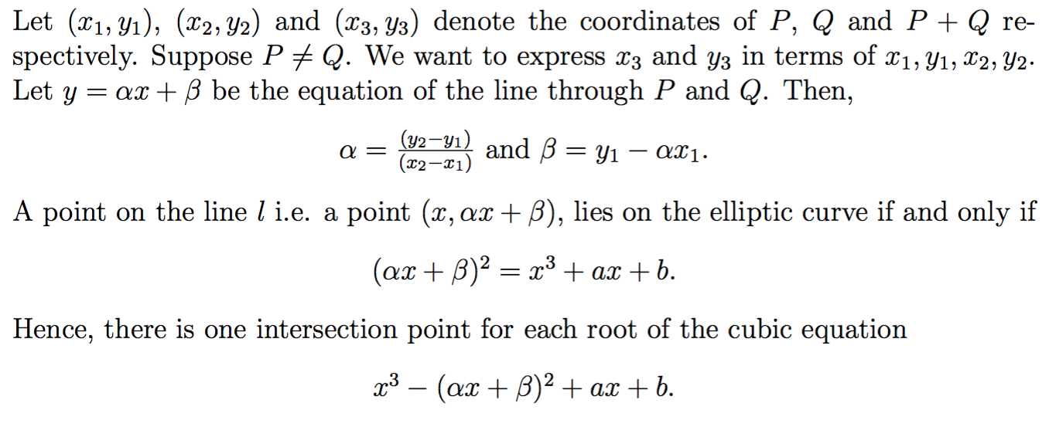
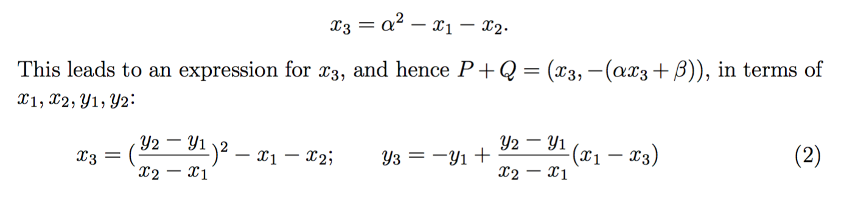
Adding P + Q

Slide 33
Adding P + Q
Pictures!

Slide 34
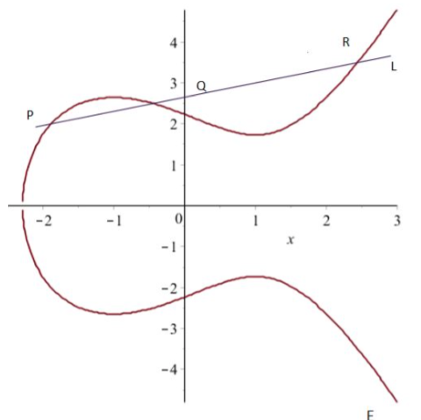
Adding P + Q = R (Chord-Tangent Process)

Slide 35
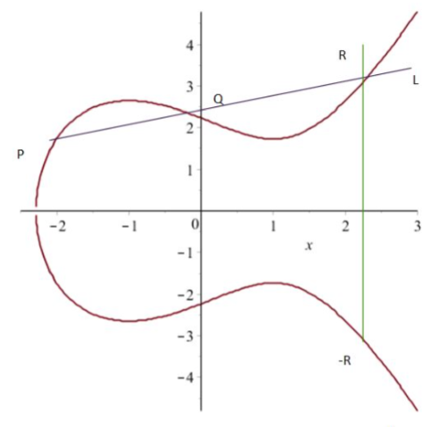
Adding P + Q = R (Chord-Tangent Process)

Slide 36
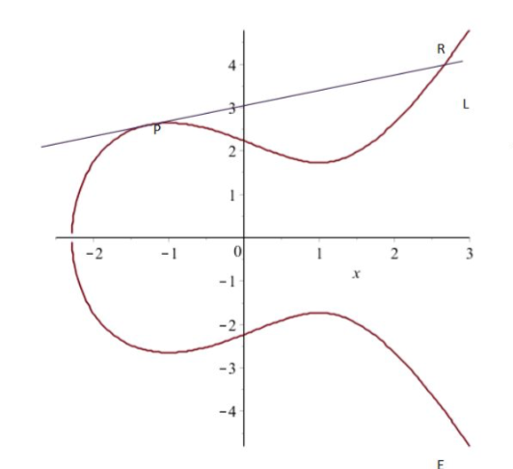
Point Doubling P + P = R (Chord-Tangent Process)

Slide 37
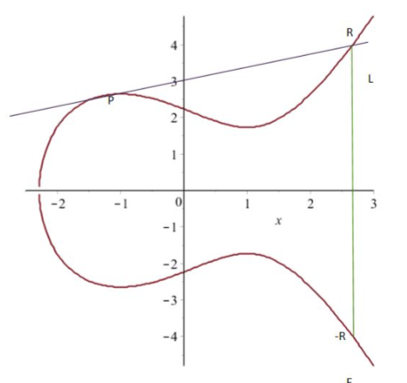
Point Doubling P + P = R (Chord-Tangent Process)

Slide 38
Elliptic GIF! (courtesy of Cloudflare)

Slide 39
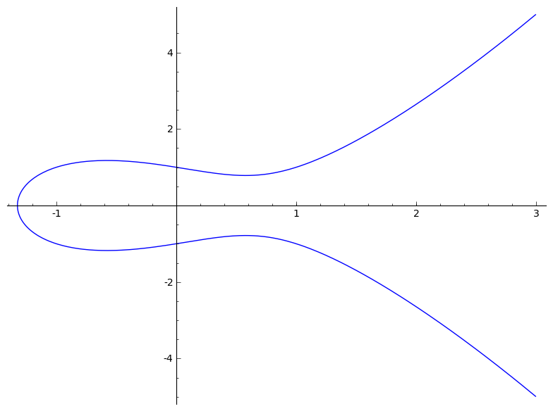
Finite Fields (Making it Discrete)

Slide 40
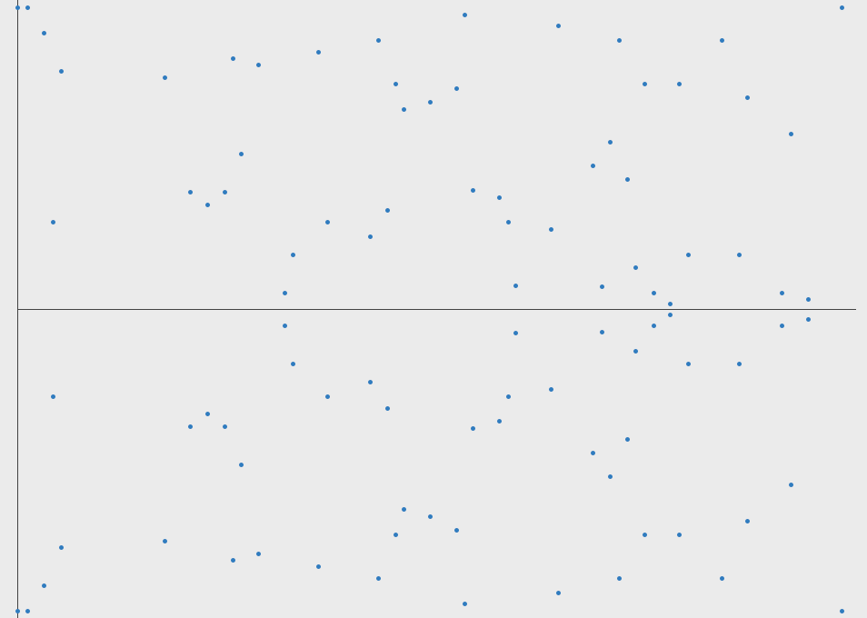
Finite Fields (Making it Discrete)
Where 0 <= x <= n -1
and x is an integer

Slide 41
Finite Field GIF!

Slide 42
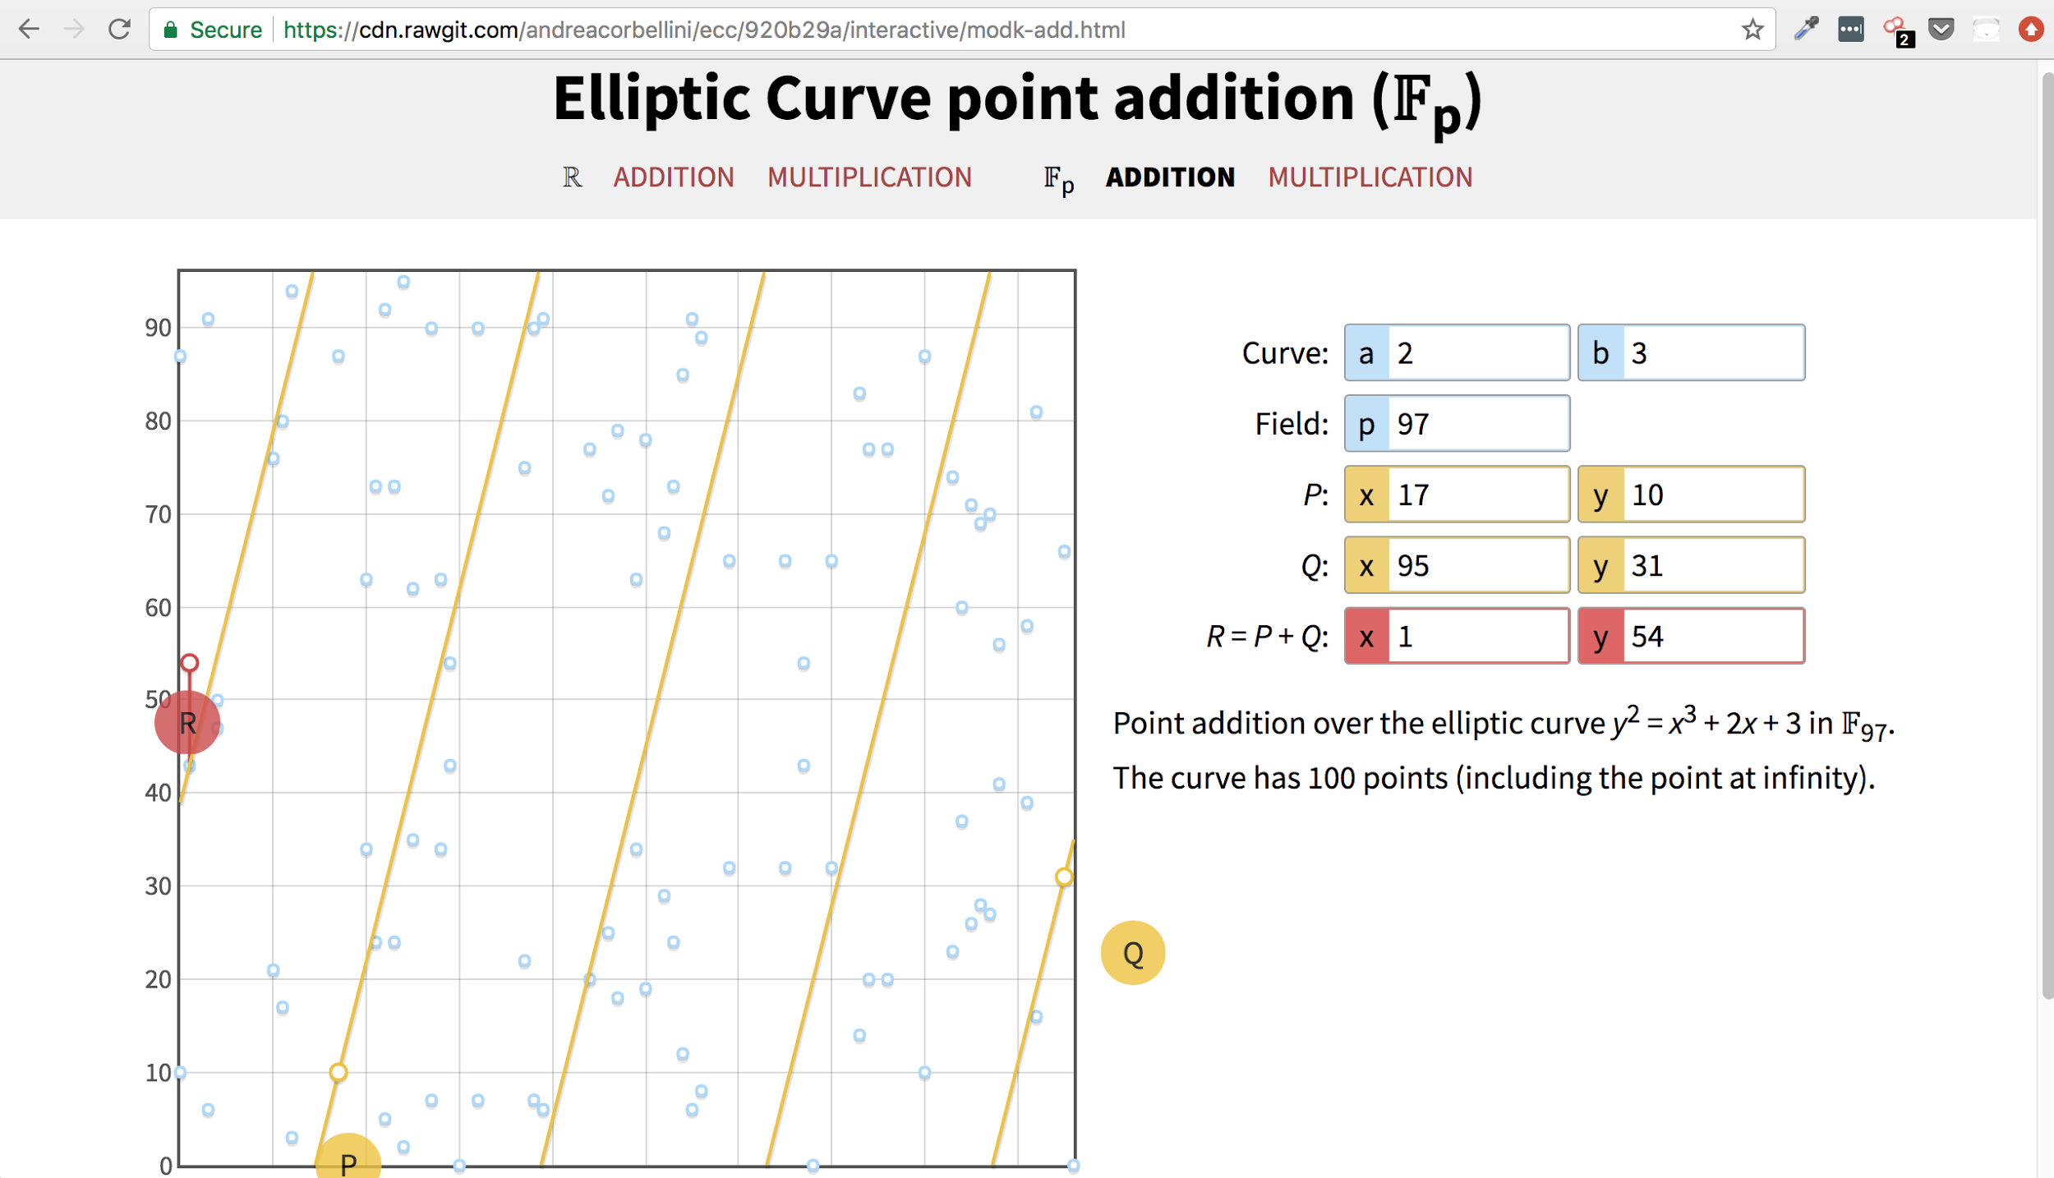

Slide 43
Finite Fields
Finite set of integer elements {0, 1, 2, 3, 4 5, 6}
Some concept of addition and multiplication (point adding/multiplying we saw earlier)
We’re interested in fields modulo some prime number p
x mod p (clock math)

Slide 44
Modular Arithmetic (remainder math)
3 (mod 12) = 3
5 (mod 12) = 5
11 (mod 12) = 11
12 (mod 12) = 12
13 (mod 12) = 1
24 (mod 12) = 12
25 (mod 12) = 1

Slide 45
Domain Parameters of Finite Fields modulo a prime
Calculate N, the order of the field (the number of points in the field)
Schoof’s algorithm (runs in polynomial time, rather than exponential time!)
Find a cyclic subgroup of F_p with large prime order n
The larger the order, the greater the security of our ECC algorithm
When it’s prime, every point is guaranteed to have a multiplicative inverse, which means we can do ECDSA!
Due to Hasse’s theorem, n is guaranteed to be a divisor of N
Calculate the base point G
Using multiplication of G, we can generate all n elements in the cyclic subgroup of order n

Slide 46
6 Domain Parameters for a Finite Field Elliptic Curve
(p, a, b, n, G, h)
p: the prime modulus
a: the a in y^3 + x^3 + ax + b
b: the b in y^3 + x^3 + ax + b
n: the order of the cyclic subgroup
G: the base point of the prime order cyclic subgroup
h: the cofactor equal to N / h

Slide 47
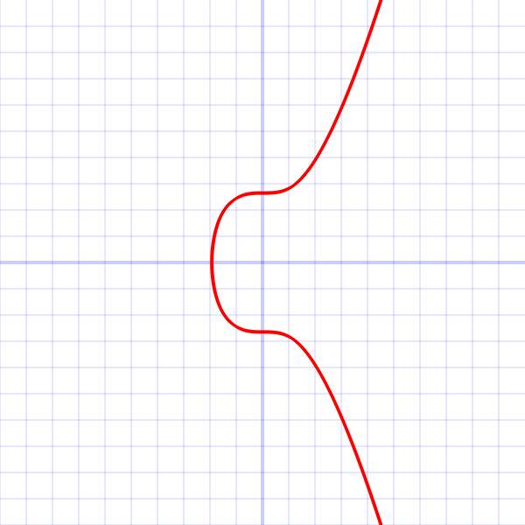
Bitcoin’s 6 Domain Parameters
secp256k1
p: 2²⁵⁶ - 2³² - 2⁹ - 2⁸ - 2⁷ - 2⁶ - 2⁴ - 1
a: 0
b: 7
n: FFFFFFFF FFFFFFFF FFFFFFFF FFFFFFFE BAAEDCE6 AF48A03B BFD25E8C D0364141
G_x: 0x79be667e f9dcbbac 55a06295 ce870b07 029bfcdb 2dce28d9 59f2815b 16f81798
G_y: 0x483ada77 26a3c465 5da4fbfc 0e1108a8 fd17b448 a6855419 9c47d08f fb10d4b8
h: 1

Slide 48
Break...
Crypto Basics
Public/Private Key Digital Signatures
“Hard” problems and “Easy” problems
Discrete Logarithm Problem
Elliptic Curves
EC Points
Point Addition
Finite Fields

Slide 49
ECDSA
Given a public key N and a private key d, we can create digital signatures using elliptic curves on a finite field
Uses small (relative to RSA) key sizes for the same level of security, 256 bit instead of 2048 bit
TLS handshake:
256 ECC: 9516.8 sign/sec
2048 RSA: 1001.8 sign/sec
This makes it faster to create signatures

Slide 50
ECDSA
Generate private key priv
Random number d which is between [1 … n] (remember n is the order of the cyclic subgroup)
Generate public key pub
Calculate pub = priv * G using double and add algorithm
= pub
= priv

Slide 51
ECDSA Signature Creation
= m,
-----BEGIN PGP SIGNATURE-----
Version: GnuPG v1
iJwEAQEKAAYFAlRGkH…..gHFLn+Lw1x6LUroOjkl2zjpoCB
6pmQPd09MglBXJfnrBI=
=ET9V
-----END PGP SIGNATURE-----
= priv,
= (r, s)
random number = k

Slide 52
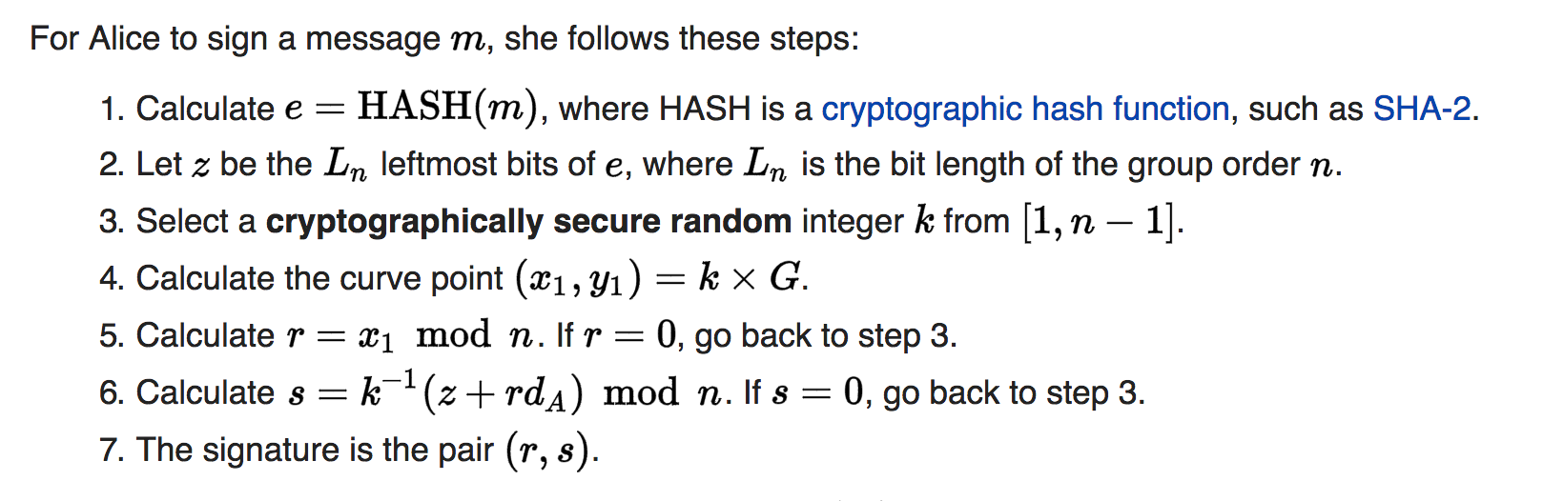
ECDSA Signature Creation

Slide 53
ECDSA Signature Verification
= m
True, False
= pub
-----BEGIN PGP SIGNATURE-----
Version: GnuPG v1
iJwEAQEKAAYFAlRGkH…..gHFLn+Lw1x6LUroOjkl2zjpoCB
6pmQPd09MglBXJfnrBI=
=ET9V
-----END PGP SIGNATURE-----
= (r, s)

Slide 54
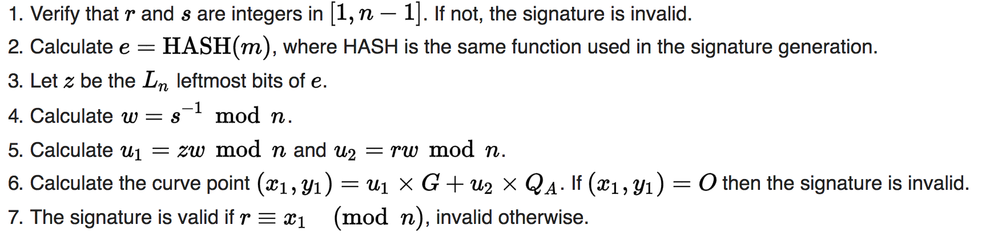
ECDSA Signature Verification

Slide 55
ECDSA and Bitcoin

Slide 56
ECDSA and Bitcoin
Bitcoin Network
I sent 5 BTC to address:
1Nf69xJt68KCAaoRHfyxsDTsQ99GuTm5s9

Slide 57
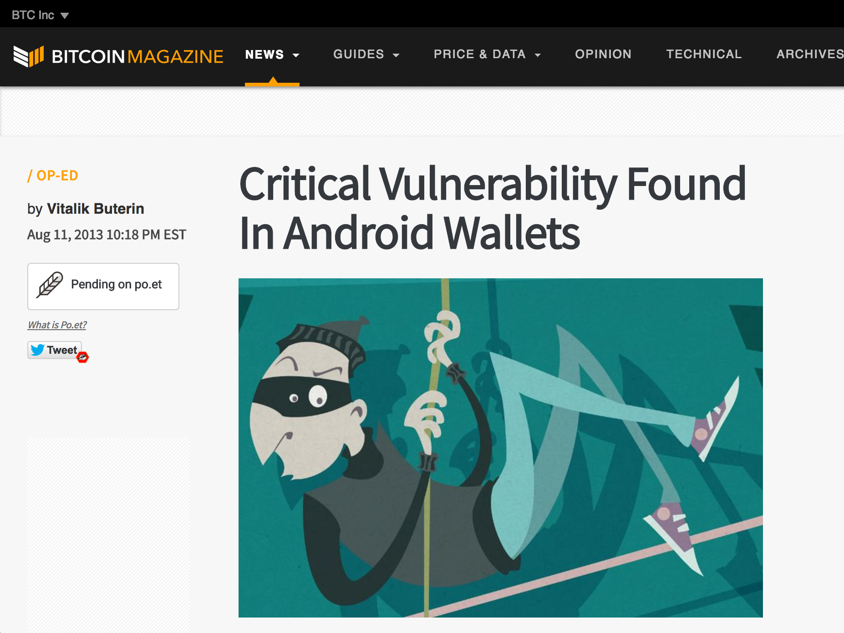
ECDSA and non-random numbers

Slide 58
ECDSA and non-random numbers

Slide 59
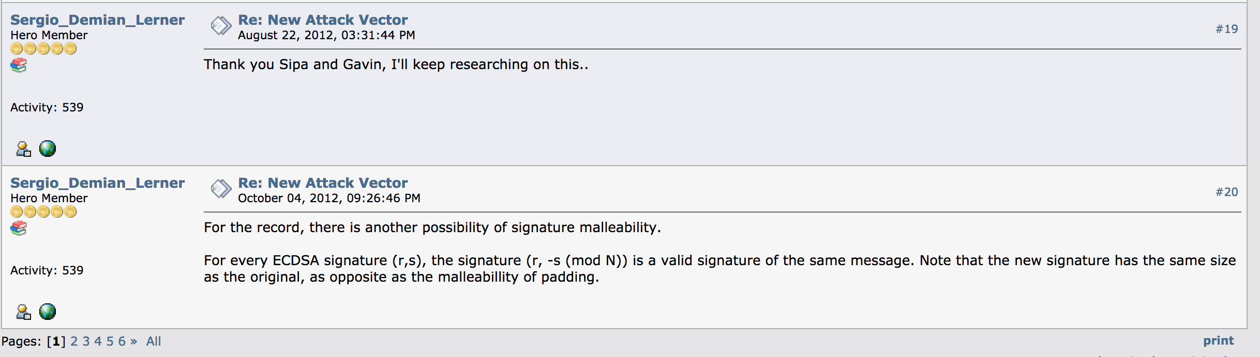
ECDSA and Transaction Malleability

Slide 60
ECDSA and Transaction Malleability
(r, s)
(r, -s (mod N))
TXID: 137f8145c9126fb3da1e558b4dac89936a719d8e75582786f533ce17330f52
TXID:
fd41cfb4d290a0d7e88c6ddfb0eebef2115499d2197f8469238c7eae3fa1930

Slide 61
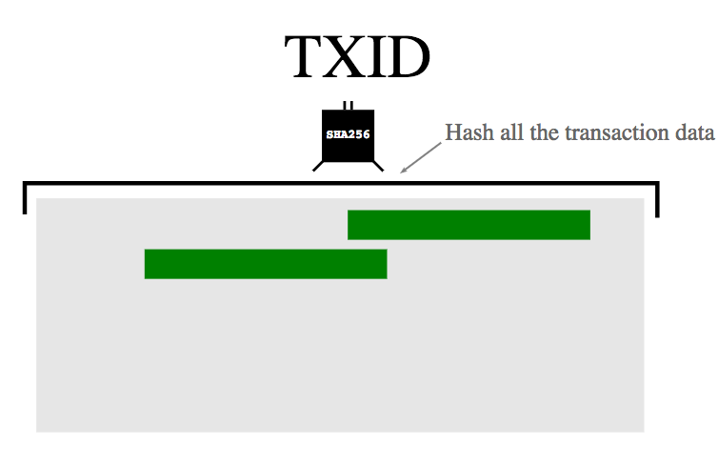
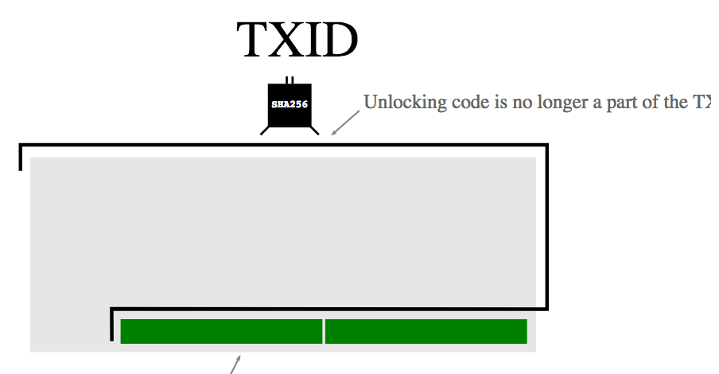
ECDSA and Transaction Malleability

Slide 62
Future Study
Methods for solving the Discrete Logarithm on Elliptic Curves
Pohlig-Hellman
Baby-step/Giant-step
Pollard’s Rho Algorithm
Schnorr Signatures
aggregatable signatures (yay multisig!)
Curves besides secp256k1
Twisted Edwards curves
Quantum Computer and ECC
Shor’s Algorithm: polynomial time solution to DLP :0
Read npm’s elliptic source code

Slide 63
References:
https://en.wikipedia.org/wiki/Elliptic-curve_cryptography
https://en.wikipedia.org/wiki/Finite_field
https://bitcoin.stackexchange.com/questions/21907/what-does-the-curve-used-in-bitcoin-secp256k1-look-like
https://crypto.stackexchange.com/questions/653/basic-explanation-of-elliptic-curve-cryptography#657
https://cdn.rawgit.com/andreacorbellini/ecc/920b29a/interactive/modk-add.html
http://andrea.corbellini.name/2015/05/23/elliptic-curve-cryptography-finite-fields-and-discrete-logarithms/
https://ellipticnews.wordpress.com/2010/12/26/elliptic-curve-cryptography-books/
https://blog.cloudflare.com/a-relatively-easy-to-understand-primer-on-elliptic-curve-cryptography/
https://blog.cloudflare.com/ecdsa-the-digital-signature-algorithm-of-a-better-internet/
http://www.cs.bris.ac.uk/~nigel/Crypto_Book/
Applied Cryptography, Bruce Schneier
https://en.bitcoin.it/wiki/Secp256k1
https://math.berkeley.edu/~ribet/parc.pdf
https://www.math.brown.edu/~jhs/Presentations/WyomingEllipticCurve.pdf
Below is a very informative article!
https://github.com/bellaj/Blockchain/blob/6bffb47afae6a2a70903a26d215484cf8ff03859/ecdsa_bitcoin.pdf
https://github.com/bitcoin/bitcoin/pull/6769

Slide 64
Double and add algorithm
Makes generating public keys go from “Hard” to “Easy”!
O(n) -> O(log(n))
Example
16P = P * P * P * … * P = 2P * 2P * 2P * 2P * 2P * 2P * 2P * 2P = 4P * 4P * 4P *4P = 8P * 8P
151P = P^7 * P^4 * P^2 * P^1 * P^0

